Slide 1
Grammar -1 (use attribute “val” for all NT)
L → E $
E → E₁ + T
E → E₁ - T
E → T
T → T₁ * F
T → T₁ / F
T → F
F → ( E )
F → num
Grammar-2 (use attribute “val” for T and F,use “lval”and “tval” for T’)
T → F T'
T' → * F T₁'
T' → ε
F → num
Grammar-3 (use attribute “op” for F,use “val” for N, “list” for T )
(use abstraction append (list,val) and removeLastN(list, val) )
S → (T)
T → F T N
T → N
F → a!
F → b!
N → num
Input: (a! b!a! 5 3 2 6)

Slide 2
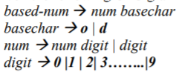
Grammar-4(use attribute “op” for F,use “val” for N, “list” for T )
(a! means for addition,
b! means subtraction)
S → (T)
T → F T N
T → N
F → a!
F → b!
N → num
Input: (a! b!a! 5 3 2 6)
Grammar-5
A ::= E F { E.f := A.s; F.k := E.z;
A.n := F.r + 1; }
Grammar-6 (Use two attributes for the number and the digit, one for the value and the second for the base)

Slide 3
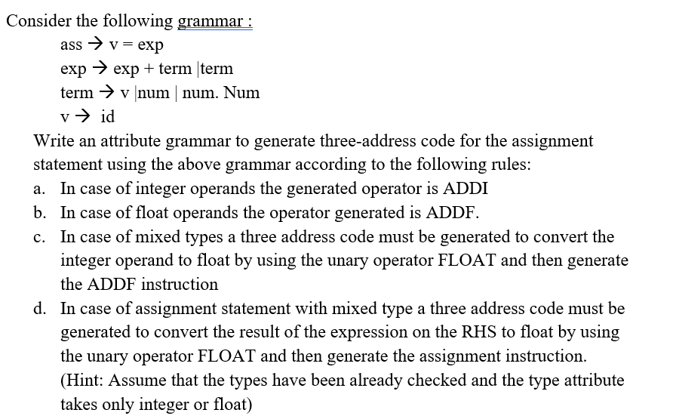
Grammar-7

Slide 4
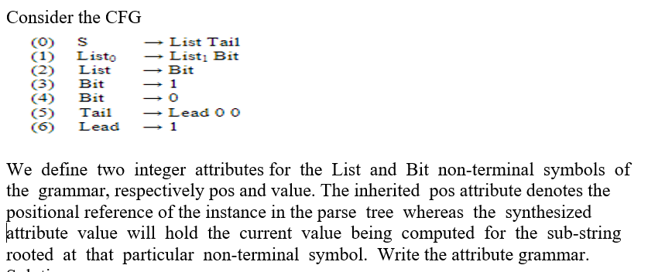
Grammar-8

Slide 5
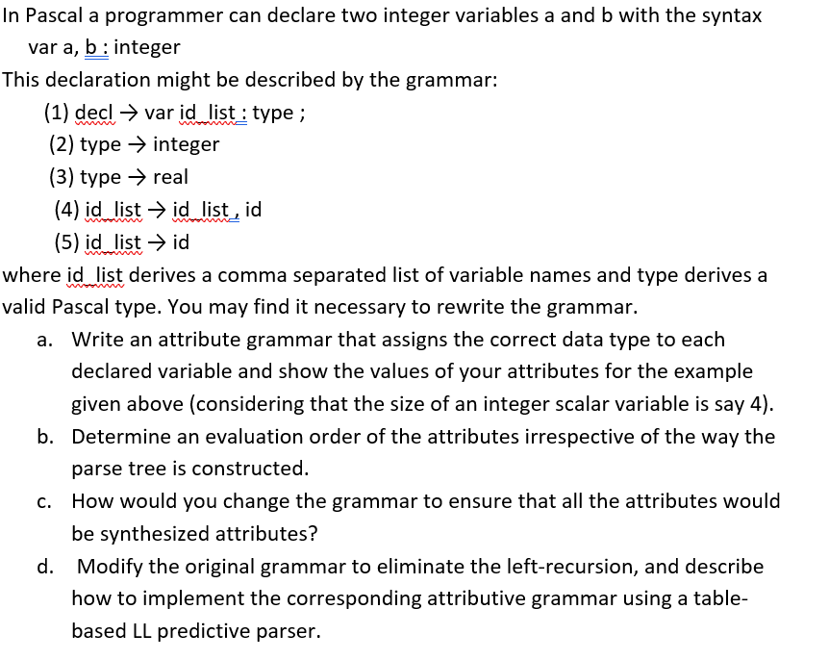
Grammar-9

Slide 6
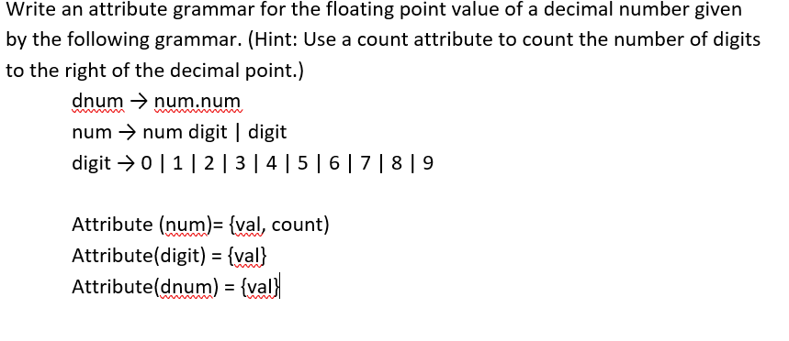
Grammar-10

